Slide 1

Sea Level Rise Projections
Gaining Insight with Predictive Analytics
Notes:
michael

Slide 2






Meet our team:
Ronda Hinz
Juliana Lima
ANALYST
AVENGERS
Michael Bernstein
Beth Sequera
Mohamed Abdelsalam
Notes:
michael

Slide 3



Introduction
Shores Under Siege: The Perils of Rising Sea Levels in Coastal Communities
Global sea level rise is a critical environmental issue driven primarily by two major factors: thermal expansion and the melting of land-based ice.
As the Earth's climate warms, the ocean absorbs more heat, causing seawater to expand and accelerating ice-shelf calving in polar regions.
Nearly 40% of the U.S. population resides in coastal regions, making them particularly susceptible to the deleterious effects of rising sea levels.
Researchers predict that “any further increase in the rate of sea level rise will lead to substantially larger, exponential changes in high-tide flooding”.¹
We must gain a better understanding of the rate at which sea level is rising. In this analysis, we will establish a model for predicting mean sea level for the next century.
¹NASA News & Features; https://sealevel.nasa.gov/news/264/why-seas-are-rising-faster-on-the-southeast-coast/; Date: June 6, 21023; Accessed: October 1, 2023
Notes:
michael - the significance of rising sea level – https://oceanservice.noaa.gov/facts/sealevel.html
((summary))speak to our decision to not include temp data but once we started reviewing we realized the temp of each city had nothing to do with the impact of sea caps in the artics

Slide 4


Data Details
Source
Website: Tides & Currents by NOAA
URL: https://tidesandcurrents.noaa.gov/stations
Available Water Monitoring Stations: 294
Criteria for Selection:
Must be coastal city
Sea level data since 1923 (uninterrupted)
Must include one target city from each region of the United States
Data Characteristics
NOAA provides real-time water level information that is updated every 6 minutes though historical data is only available in 3 intervals.
We opted for water level data summarized by month for all 7 target cities.
Reason: The timeline for this analysis spans 200 years. As such, mean values are sufficient.
Temperature Data
Global warming is driven by atmospheric temperature changes. Why not include temperature data in the analysis?
Reason: Despite the undeniable connection between global warming and sea level rise, the relationship is complicated at best. Since regional temperatures at each target city have no direct impact on freshwater melt in polar regions, we have elected to omit this information.
Notes:
michael

Slide 5
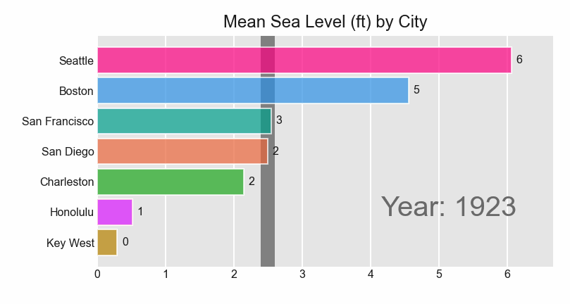
Coastal Dynamics Spanning 1923-2023
Note: Perpendicular Bar = Mean Sea Level for each period/year displayed.
Notes:
Beth

Slide 6
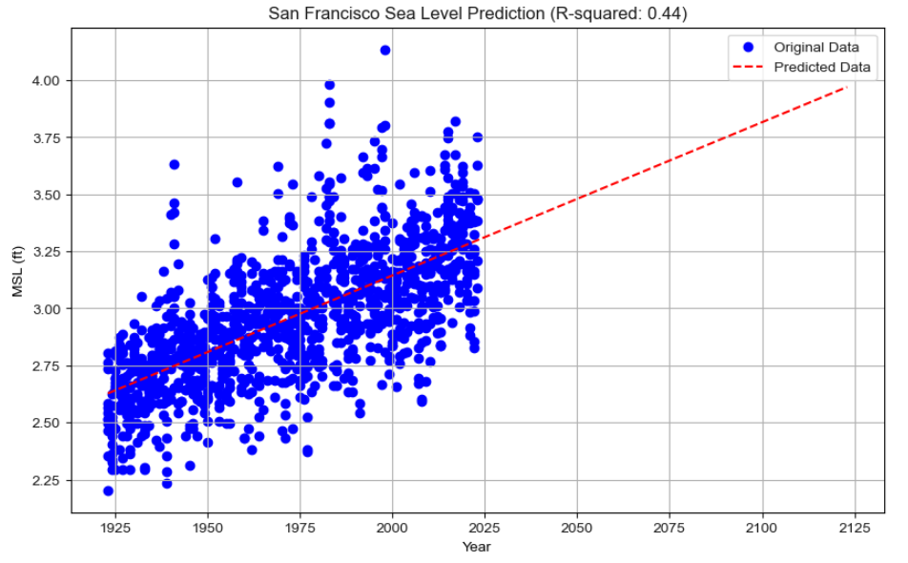
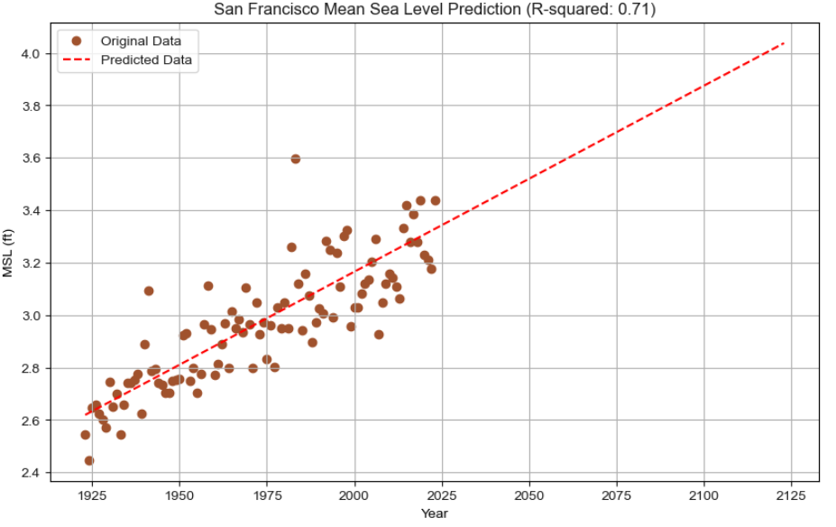
Mean Sea Level Predictions with Linear Regression Model
GOAL: Predict mean sea level for the next 100 years (2024-2123) in each of the target coastal cities by analyzing the previous 100 years (1923-2022) of sea level data using a linear regression model.
1st attempt: Station data grouped by month. Calculated mean sea level for each month. (Figure 1.)
Result: Messy scatter plot with a low R-squared value for all cities. R-squared ranged from 0.37 to 0.69.
2nd attempt: Station data grouped by year. Calculated mean sea level for each year. (Figure 2.)
Result: Data points are more tightly clustered around the regression line with significantly higher R-squared values ranging from 0.64 to 0.89.
Figure 1.
Figure 2.
Notes:
Ronda

Slide 7
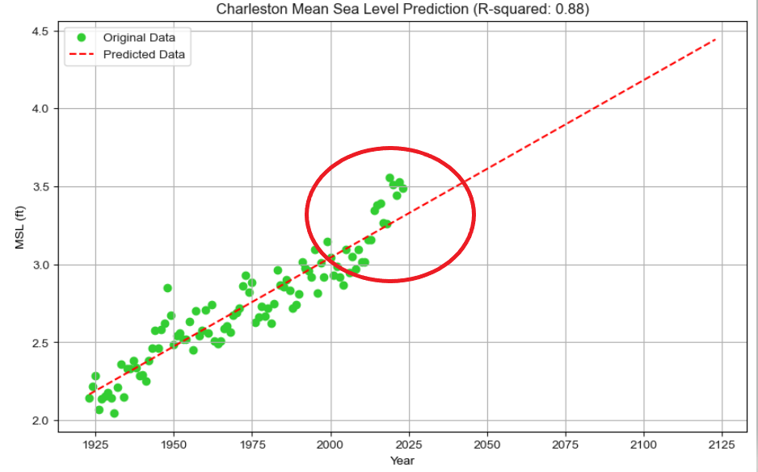
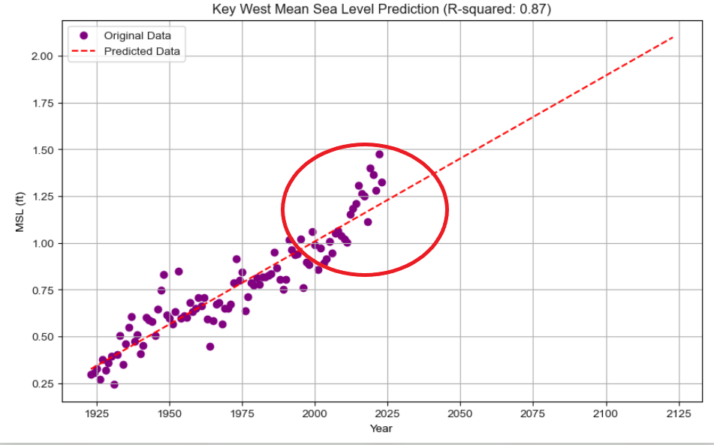
Mean Sea Level Predictions with Linear Regression Model
According to a 2017 report from NOAA: “Although the sea level has risen by 6.5 inches since 1950, nearly half of it (3 inches) has occurred in just the last 20 years.”
While this accelerated rate of sea level rise is captured in the scatter plots (see examples below), the linear regression model is ill-suited for capturing nonlinear trends of this nature. We would need to fit the data to a polynomial regression model to capture the dynamics of this dataset.
Notes:
Ronda

Slide 8
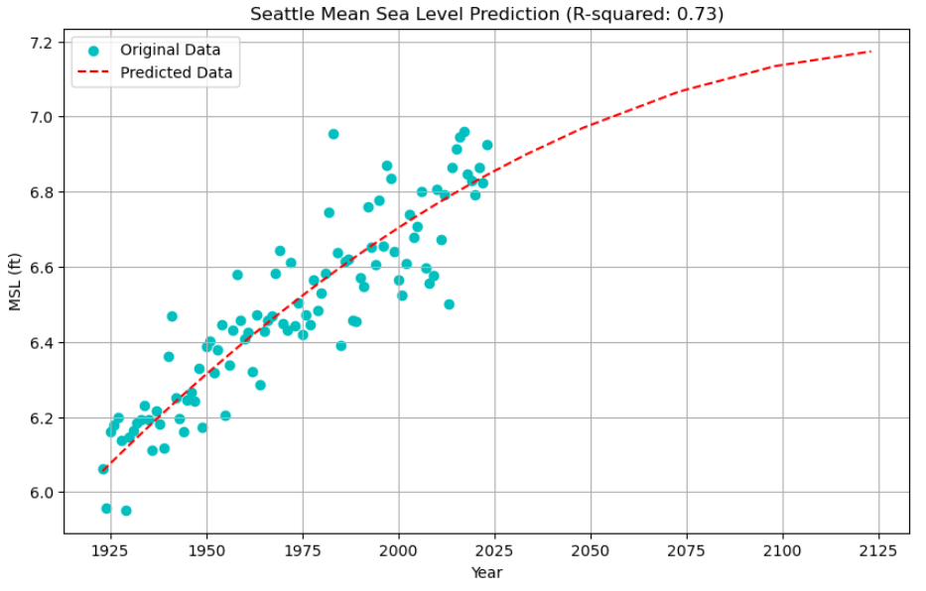
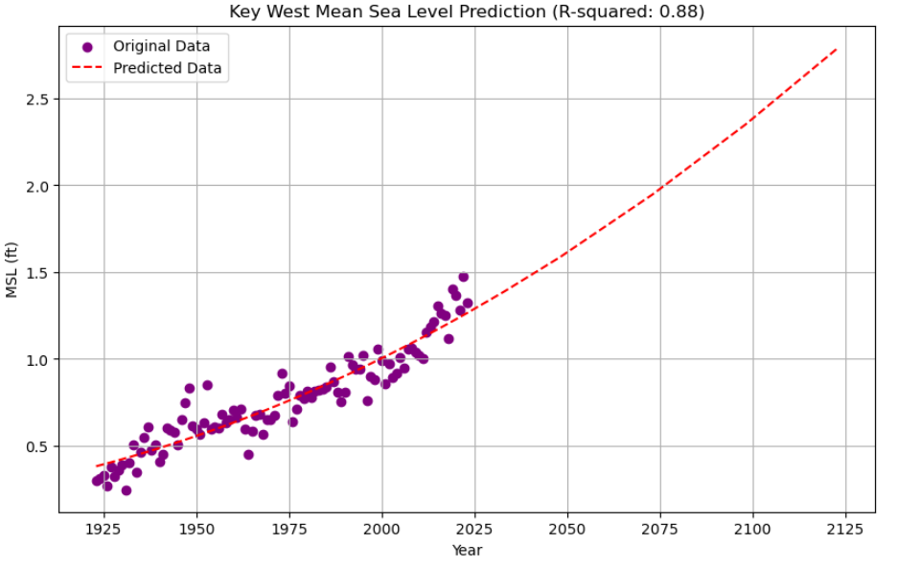
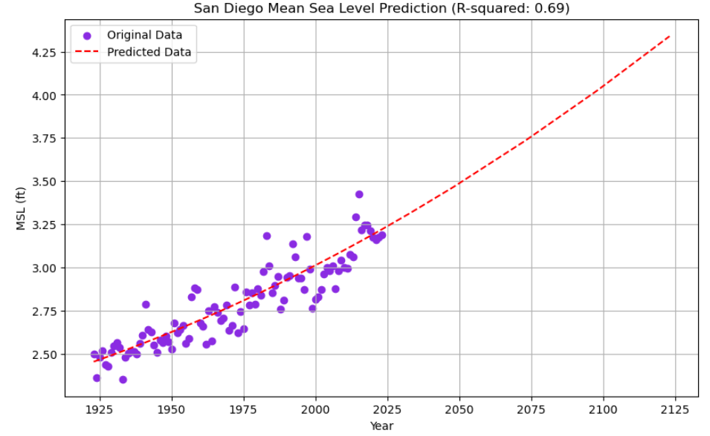
Mean Sea Level Predictions with Polynomial Regression Model
With the polynomial regression model (degree = 3), we are finally able to visualize the dynamic nature of sea level rise at each of our target cities.
Notes:
Ronda

Slide 9
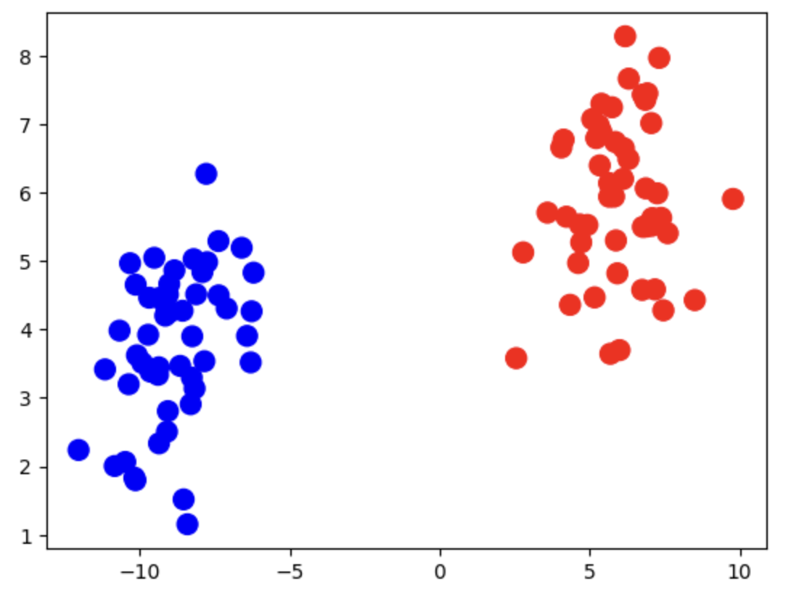
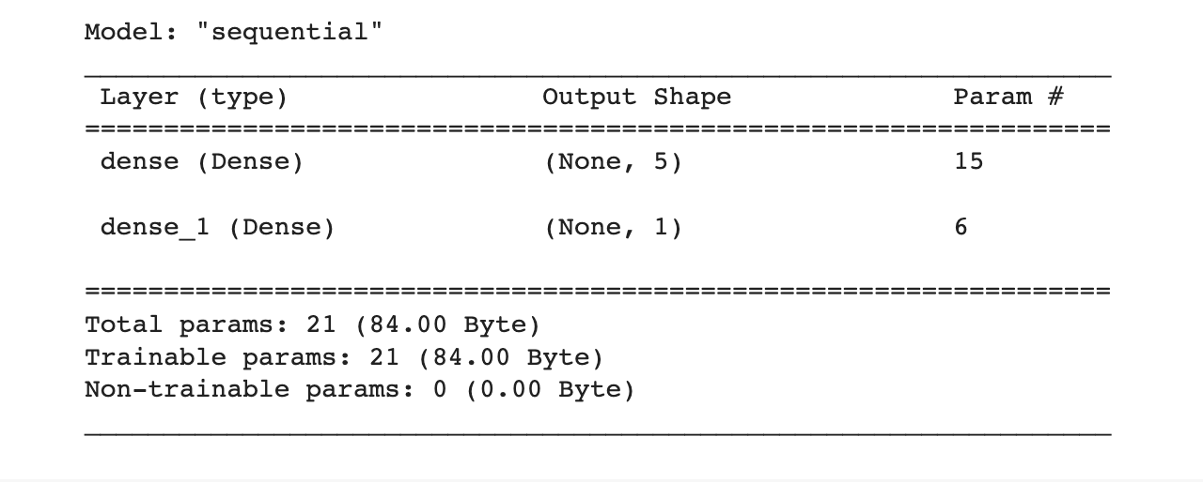
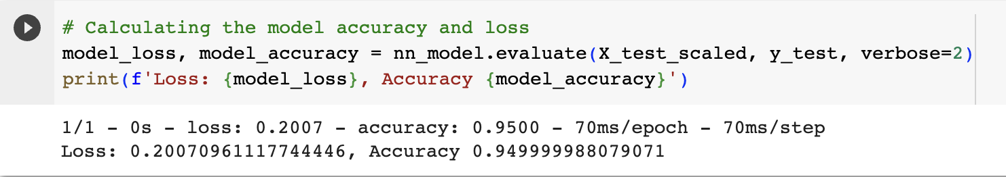
Neural Model
Notes:
Mohamed

Slide 10
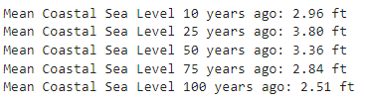

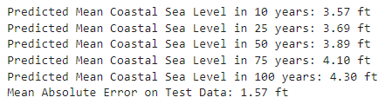

Mean Sea Level for Target Cities (combined)
(1923-2023)
YEAR:
2013
1998
1973
1948
1923
Sea Level Predictions for Target Cities (combined)
(2023-2123)
YEAR:
2033
2048
2073
2098
2123
Notes:
Juliana

Slide 11
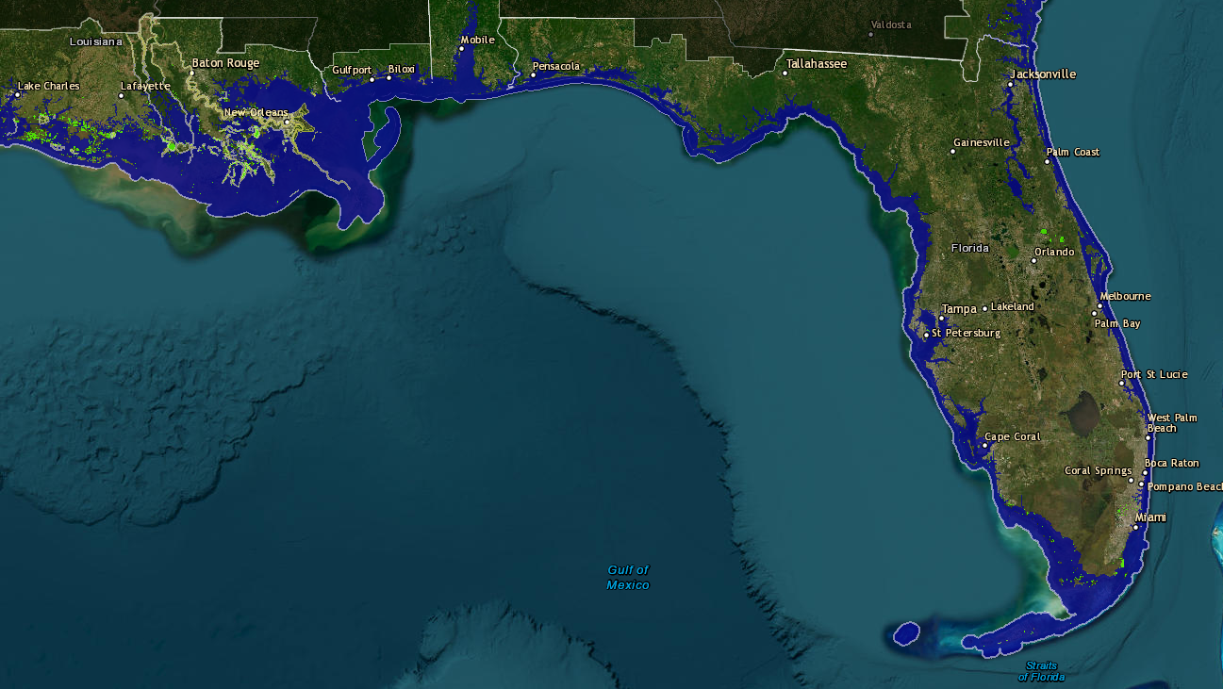
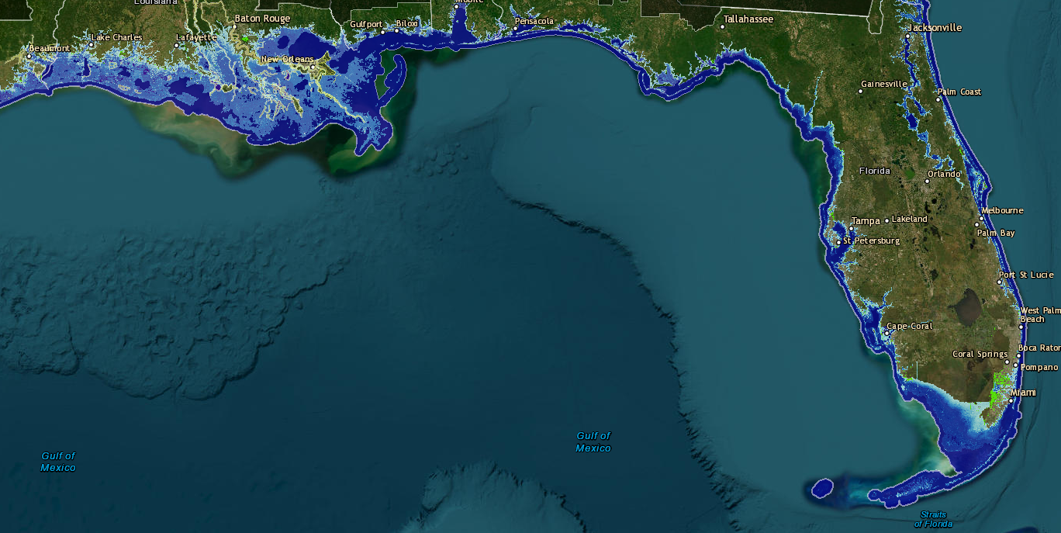
Sea Level Projections:
Florida & New Orleans
CURRENT
2123
“Sea Level Rise Viewer. Retrieved from https://coast.noaa.gov/slr/#/layer/slr/5/-9546220.994261397/3259751.0165892434/7/satellite/37/0.8/2080/high/midAccretion." Accessed: October 2, 2023
Notes:
Juliana

Slide 12
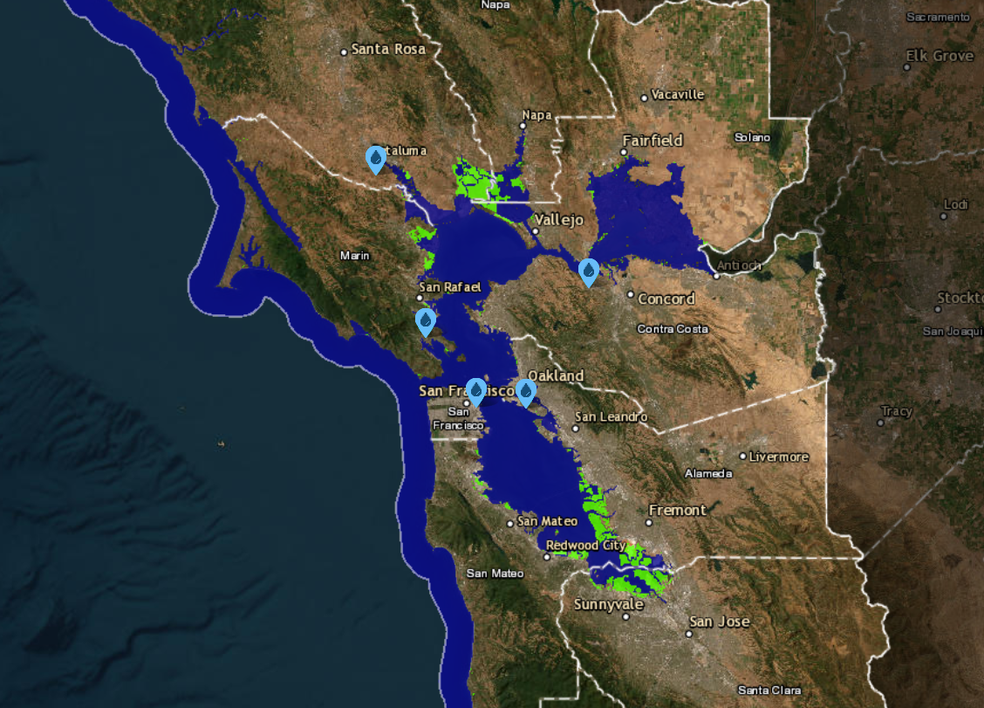
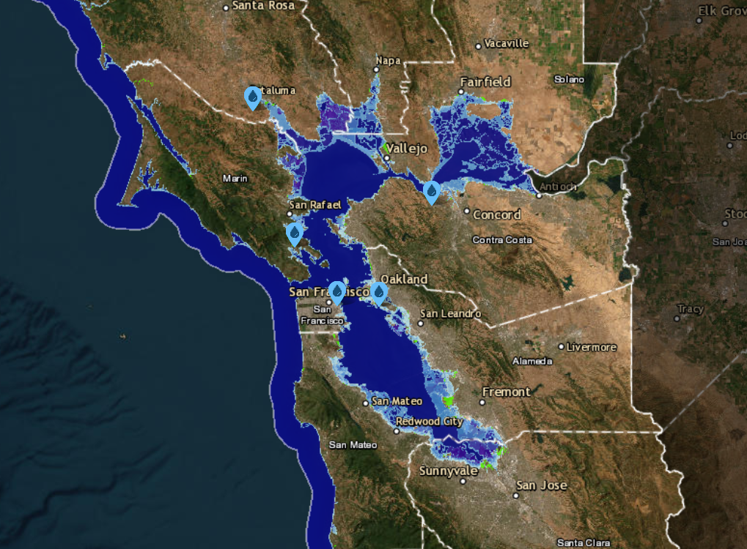
Sea Level Projections:
San Francisco
CURRENT
2123
“Sea Level Rise Viewer. Retrieved from https://coast.noaa.gov/slr/#/layer/slr/5/-9546220.994261397/3259751.0165892434/7/satellite/37/0.8/2080/high/midAccretion." Accessed: October 2, 2023
Notes:
Juliana

Slide 13
Thank You
Notes:
conclusion: while we were able to confirm sea levels are rising, there are other effects that our model couldn’t take into effect since the east and west coast regions have different landscapes

